Slide 1




Food Wastage
Management System
Data-driven Solution for Tracking Food Donations and Claims

Slide 2


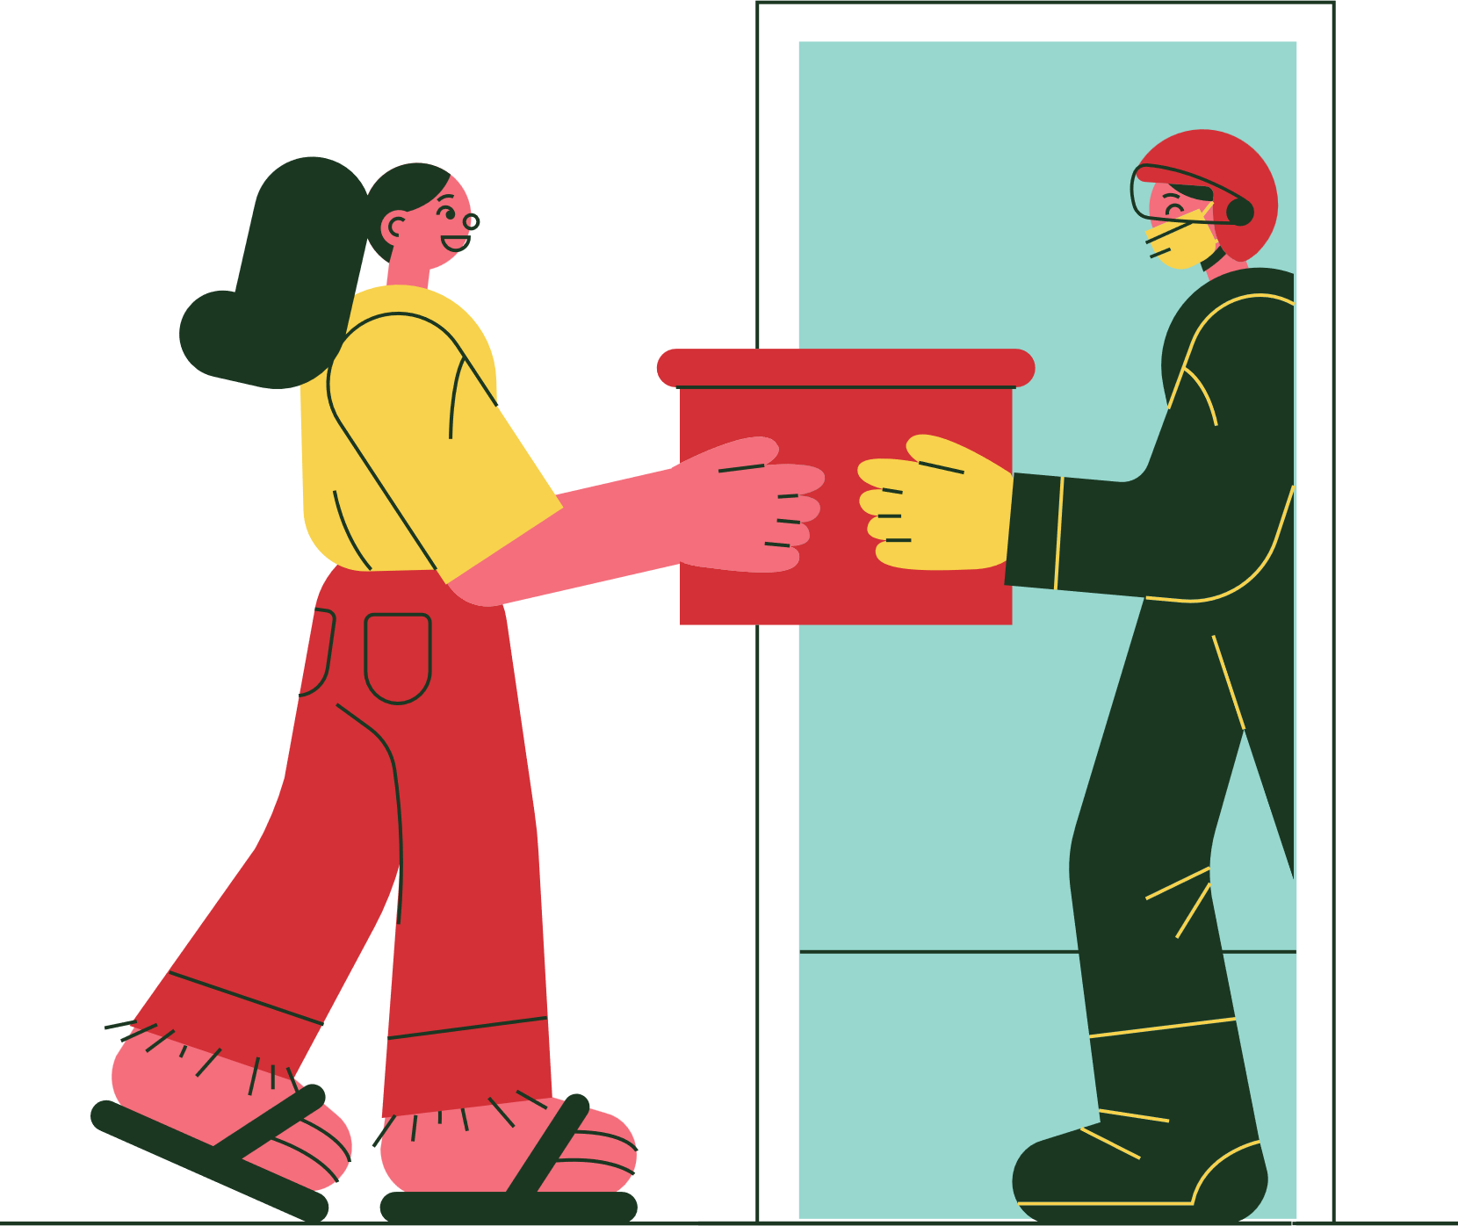
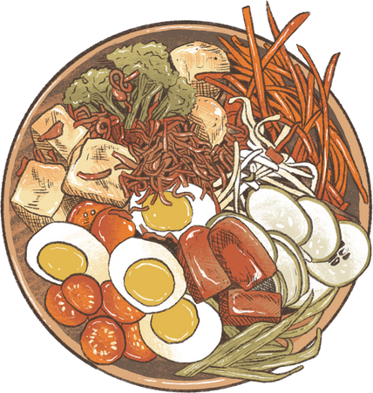

Project Objective
Content
Track food availability, donations, and claims.
Reduce food waste by connecting providers to receivers.
Perform real-time data analytics and reporting using SQL.
Receiver
Provider
Food
Claim

Slide 3


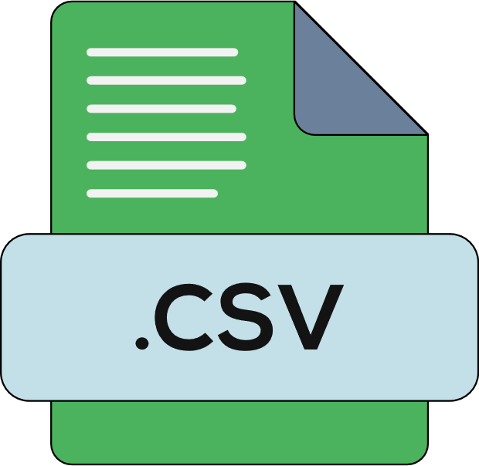


Tools & Technologies
Content:
Python (Pandas, MySQL connector): Data cleaning, manipulation.
MySQL: Data storage and querying.
VS Code: Development environment.
Streamlit : Visualizations
CSV Files: Data source for provider, receiver, food listings, claims.
Image Idea:
Python + MySQL + CSV + Pandas +Streamlit

Slide 4



Data Sources
Content Table:
Dataset Description
providers_data Info about food providers
receivers_data Info about food receivers
food_listings Food available for donation
claims_data Who claimed what and when

Slide 5
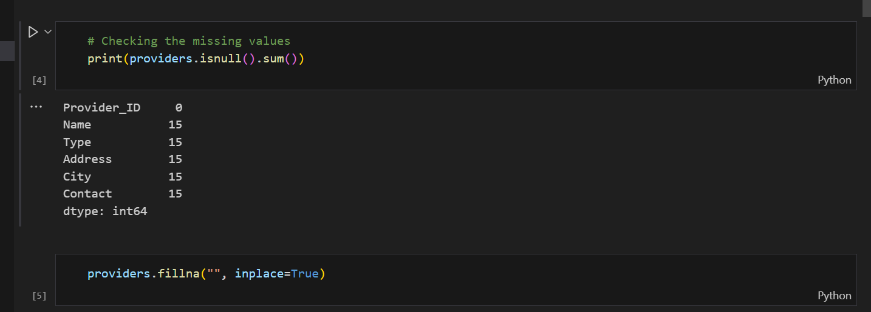

🧼 Data Preprocessing
Content:
Used .isnull().sum() and .fillna('') to handle missing data.
Verified data types using .info().
Normalized column data for consistency before database import.

Slide 6


🗃 Database Schema
Tables Created:
giver – Food providers
target – Receivers
provisions – Food listings
petitions – Claims made

Slide 7

🔍 Key SQL Queries & Insights
Content (with small summaries):
Top contributing food provider types.
Cities with highest receivers.
Quantity and type of food claimed/donated.
Food items nearing expiry and unclaimed.

Slide 8
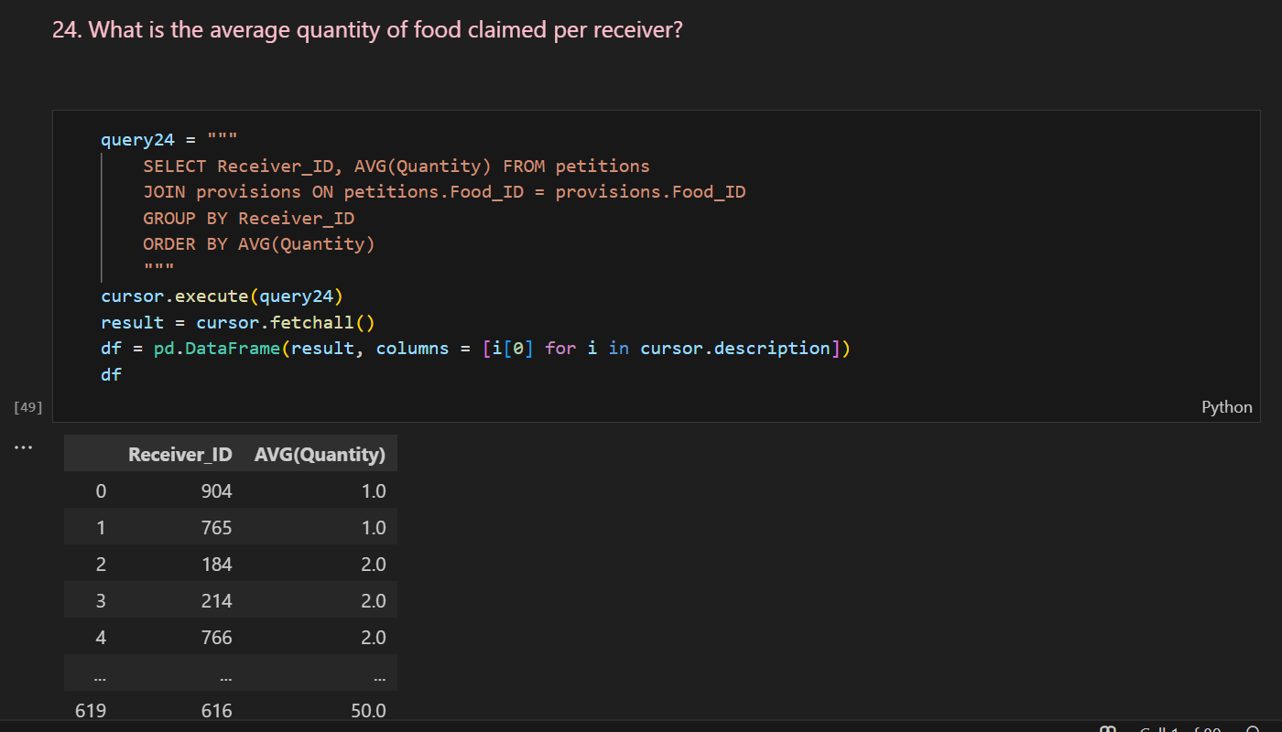
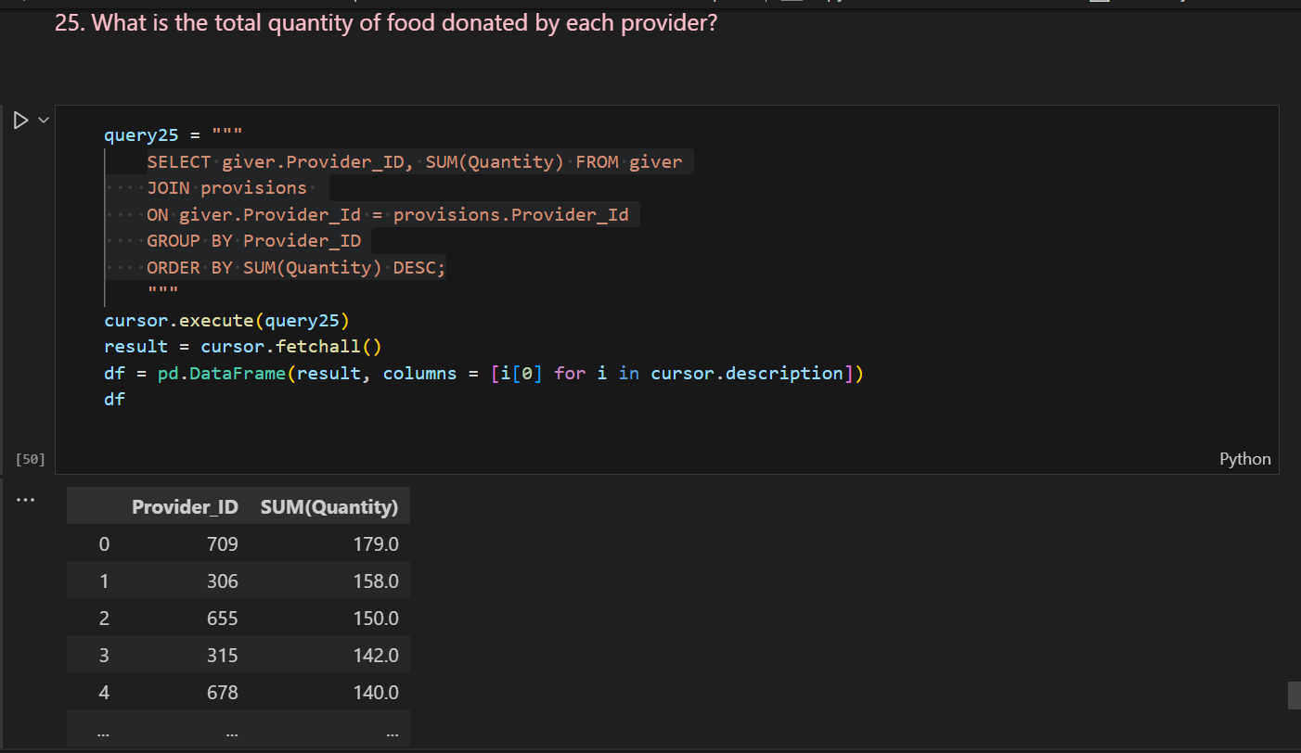
🔍 Key SQL Queries & Insights

Slide 9
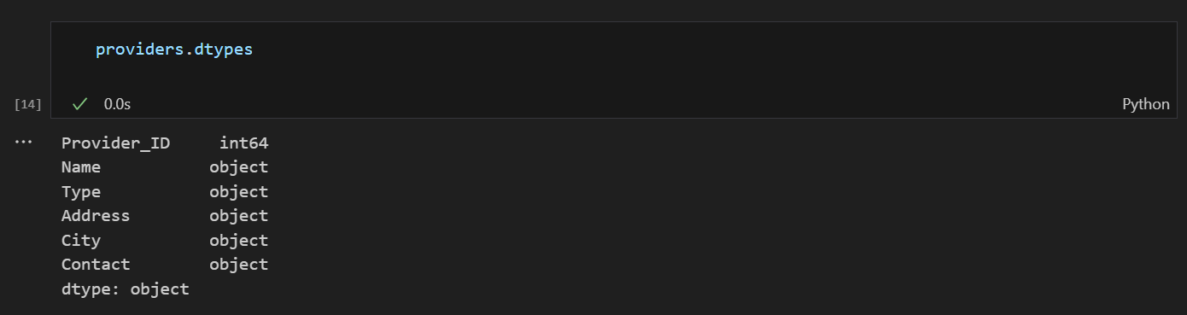

⚠️ Challenges & How I Solved Them
Content:
Large CSV file sizes → Optimized loading using dtype and indexing.
Duplicate rows → Used INSERT IGNORE in SQL.
Date formats → Standardized with pd.to_datetime().

Slide 10

🏁 Project Outcomes
Content:
Created a fully relational backend to manage food donations.
Enabled analytical queries for decision-making.
Reduced waste visibility through data.

Slide 11

📌 Project Summary
Content:
Project: Food Wastage Management System
Developed a relational database and analytics engine using Python and MySQL to track food donations and claims, enabling optimized distribution and reducing waste. Integrated data pipelines from CSV, performed advanced SQL queries, and visualized insights with Pandas.

Slide 12
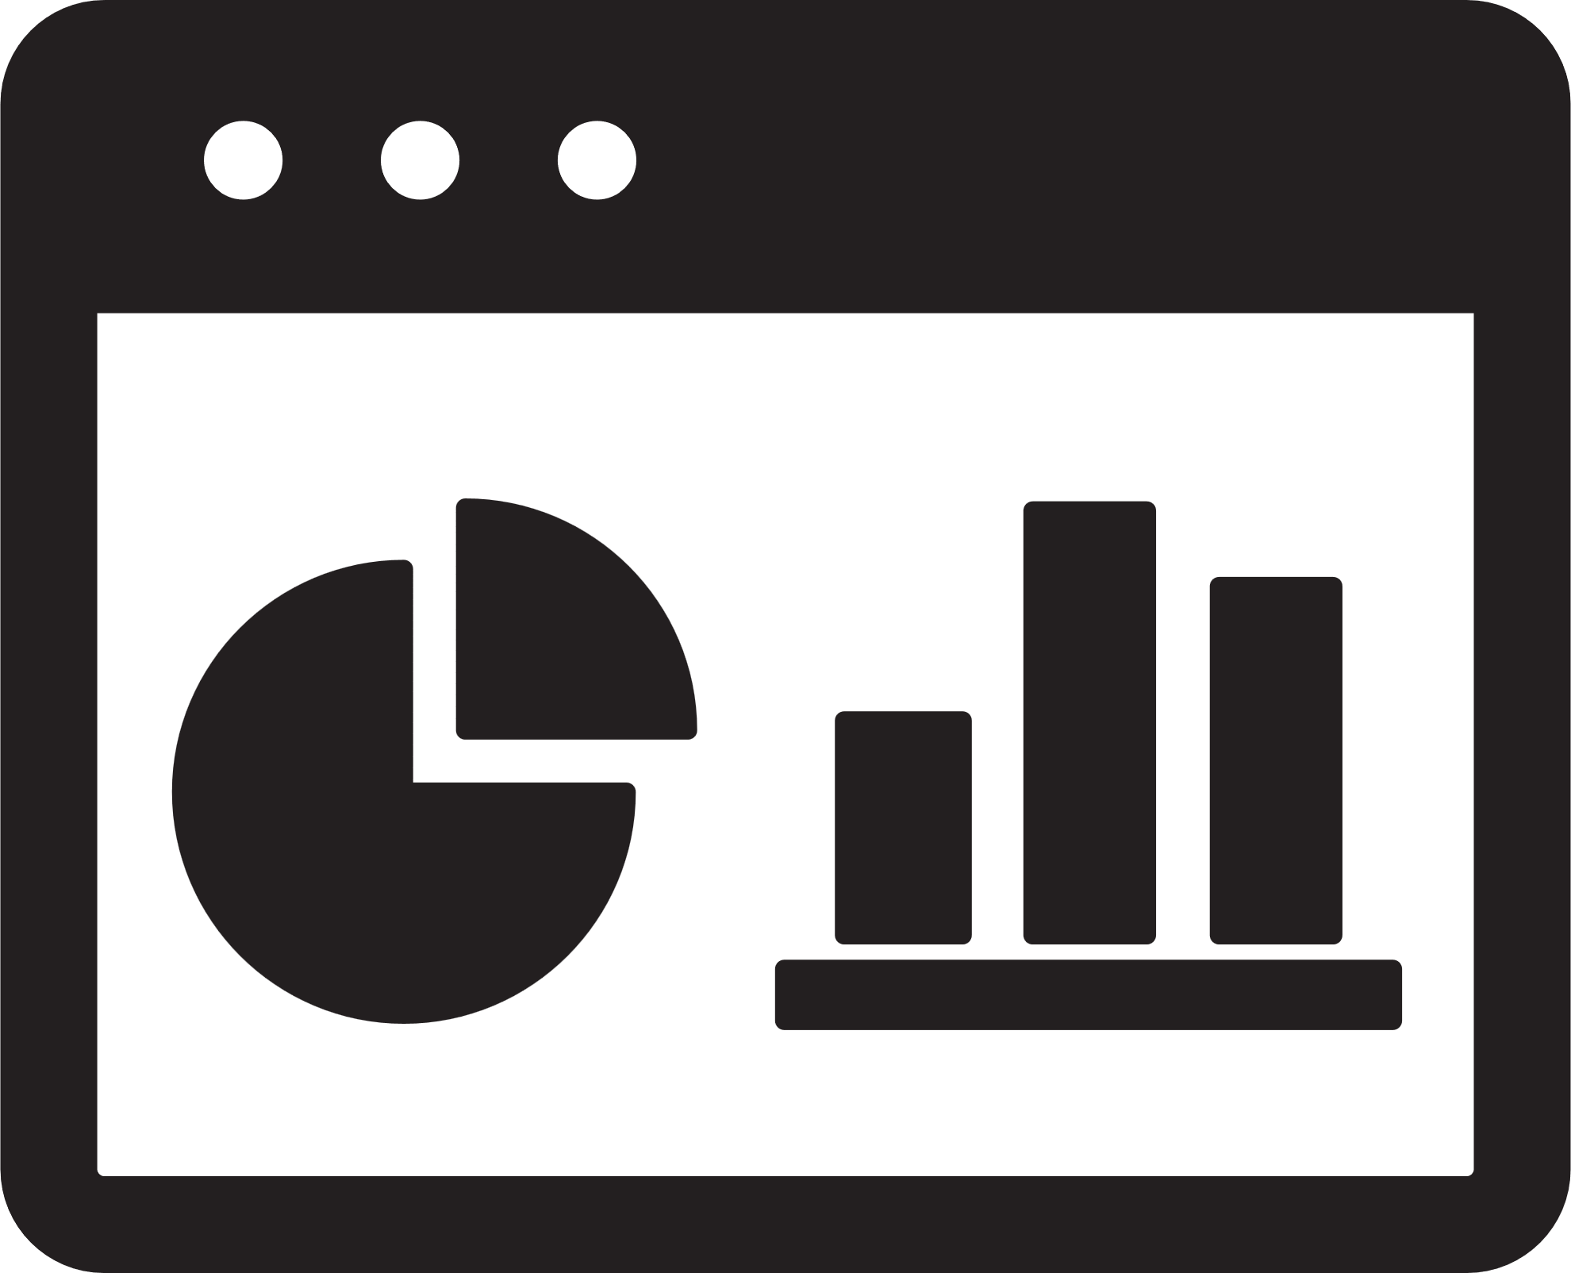
🚀 Streamlit-Powered Data Visualization
Content:
Developed a user-friendly web app to visualize food donations and claims.
Integrated interactive filters for real-time data exploration.
Dynamic charts to analyze food availability, receivers, and trends.

Slide 13
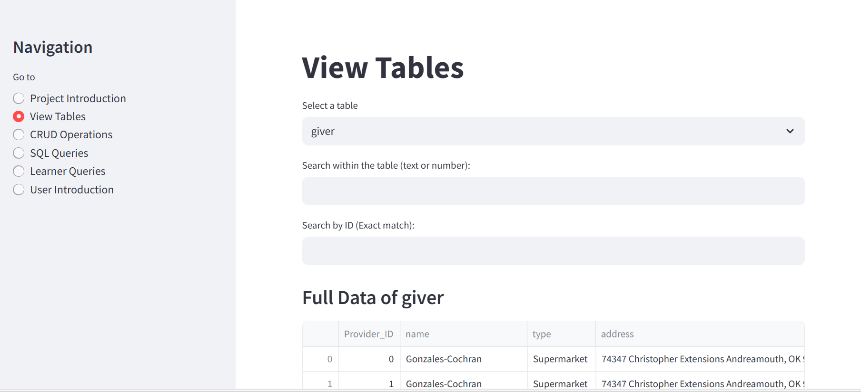
🚀 Streamlit-Powered Data Visualization

Slide 14
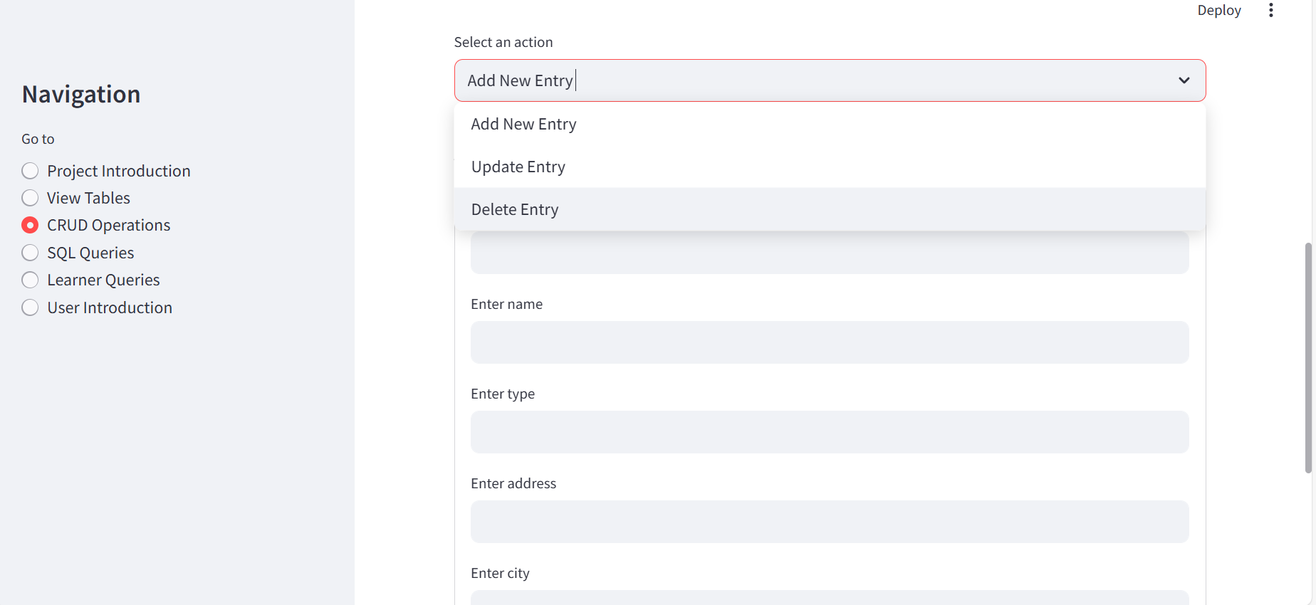
🚀 Streamlit-Powered Data Visualization

Slide 15
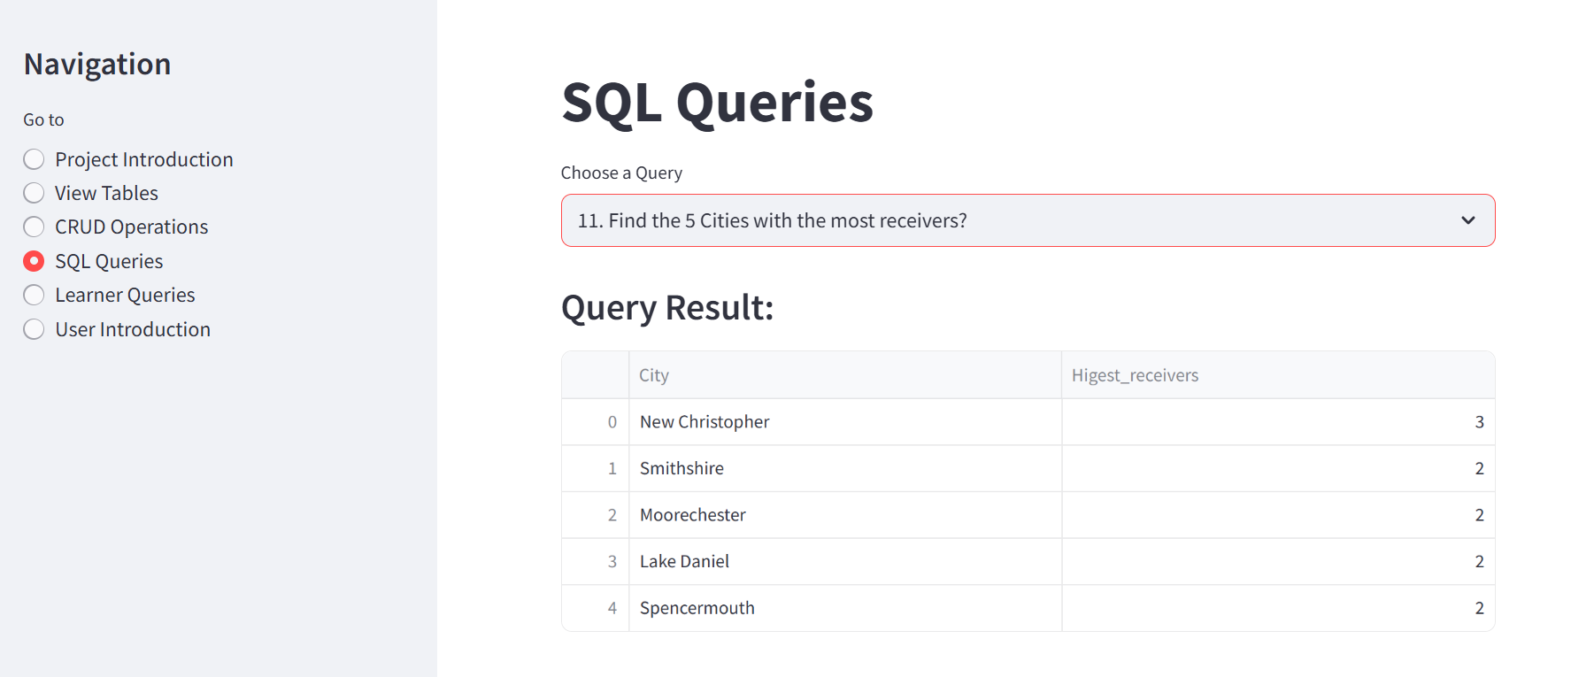
🚀 Streamlit-Powered Data Visualization

Slide 16
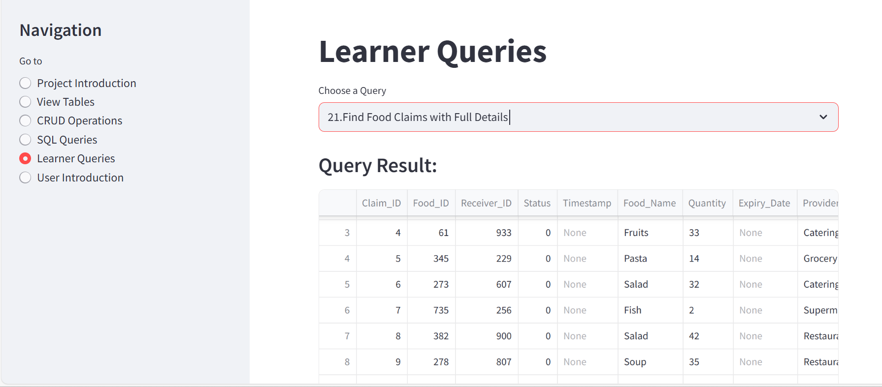
🚀 Streamlit-Powered Data Visualization

Slide 17
📊 Why Streamlit Over Traditional Reports?
Content:
Interactivity: Users can filter, sort, and analyze without writing queries.
Real-time updates: Direct connection to MySQL ensures live data.
Better visualization: Graphs & tables are more engaging than static CSV reports.
Web-based: No need to install Jupyter—accessible via browser.

Slide 18



🙏 Thank You!
Contact: sachimcmf@gmail.com
LinkedIn: www.linkedin.com/in/sachin-hembram-aa8225305

